Slide 1


Department of Computer Science and Engineering
Smart Traffic Control System with
Emergency Vehicle Detection using IOT
B21A2425C19
Manya Karthik - 210701152
Nitish K - 210701183
Dr. Muneeshwari P
Professor

Slide 2
Problem Statement and Motivation
Current traffic control systems, even with IoT integration, face significant challenges in managing urban traffic efficiently. These systems often struggle with real-time data processing, leading to delays in traffic signal adjustments and suboptimal traffic flow. Emergency vehicle prioritization is frequently ineffective, causing prolonged response times and safety risks. The integration of IoT technology with existing infrastructure is complex and costly, while data security and privacy concerns arise from continuous data transmission. These issues result in inefficiencies, increased congestion, and reduced road safety. The motivation for addressing these problems stems from the need for better traffic management due to rising vehicle volumes, rapid urbanization, and the demand for more efficient emergency responses.

Slide 3
Objectives
To develop an automated traffic signal control system that prioritizes emergency vehicles using IR sensors and voice recognition technology. The system aims to:
1. Detect: Identify the presence of emergency vehicles using IR sensors.
2. Recognize: Use voice recognition to confirm emergency vehicle sirens.
3. Prioritize: Automatically adjust traffic signals to give priority to emergency vehicles, ensuring they have a clear path.
4. Integrate: Seamlessly work with existing traffic control infrastructure.
5. Enhance Safety: Reduce response time for emergency services, improving public safety and saving lives.

Slide 4
Abstract
In densely populated countries, traffic congestion poses a significant challenge, especially for emergency vehicles such as ambulances. These vehicles often get stuck in traffic, leading to delays that can be life-threatening. To address this critical issue, we propose an automated system designed to detect emergency vehicles in heavy traffic conditions and facilitate their swift movement. The system utilizes algorithms to identify ambulances within congested traffic environments. Upon detection, the system can either alert traffic controllers or autonomously guide surrounding vehicles to clear a path, ensuring the ambulance can navigate through the traffic with minimal delay. This approach aims to enhance the efficiency of emergency response, reduce the risk of delayed medical assistance, and ultimately save lives. By integrating real-time traffic data and automated vehicle communication, the proposed system offers a practical and scalable solution to a problem that is increasingly becoming a public safety concern in urban settings.

Slide 5
System Architecture
1. Sensing and Detection Layer
IR Sensors: Placed along lane edges to detect emergency vehicles by sensing their presence in specific lanes. These sensors detect interruptions in the infrared beam, signaling the presence of an ambulance.
Voice Recognition Module: This module recognizes the distinct sound frequency and pattern of an ambulance siren, confirming an active emergency vehicle presence.
Arduino Microcontroller (e.g., Arduino Uno): Central controller that processes data from IR sensors and the voice recognition module.

Slide 6
2. Communication and Control Layer
Arduino as Central Controller: Controls traffic lights in response to signals from IR sensors and the voice recognition module.
Traffic Light Control: Automatically manages red, yellow, and green signals to prioritize lanes where emergency vehicles are detected, providing a clear path.
3. Processing and Actuation Layer
Traffic Light Module: Connected to Arduino, this module changes traffic signals dynamically to green in the ambulance’s lane, maintaining red in other lanes.

Slide 7
Output Display: LCD displays traffic status and other necessary information, allowing nearby vehicles to recognize emergency traffic priority visually.
4. User Interface Layer
Traffic Management Dashboard: Allows traffic controllers to monitor the system, override signals if necessary, and view lane occupancy data.
5. Security and Privacy Layer
Data Encryption and Access Control: Ensures that communication between modules and central controllers is secure, preventing unauthorized control.

Slide 8
List of Modules
IR Sensor Module for Lane Detection: Detects the presence of vehicles in specific lanes. Uses multiple IR sensors placed at lane edges to monitor traffic, specifically detecting ambulances.
Voice Recognition Module for Siren Detection: Identifies the sound of ambulance sirens. Utilizes a pre-trained voice recognition algorithm to differentiate sirens from background noise.
Traffic Light Management Module: Adjusts traffic lights based on inputs from the IR sensors and voice recognition module. Prioritizes the ambulance's lane by changing the traffic light to green, ensuring a clear path for the emergency vehicle​.

Slide 9
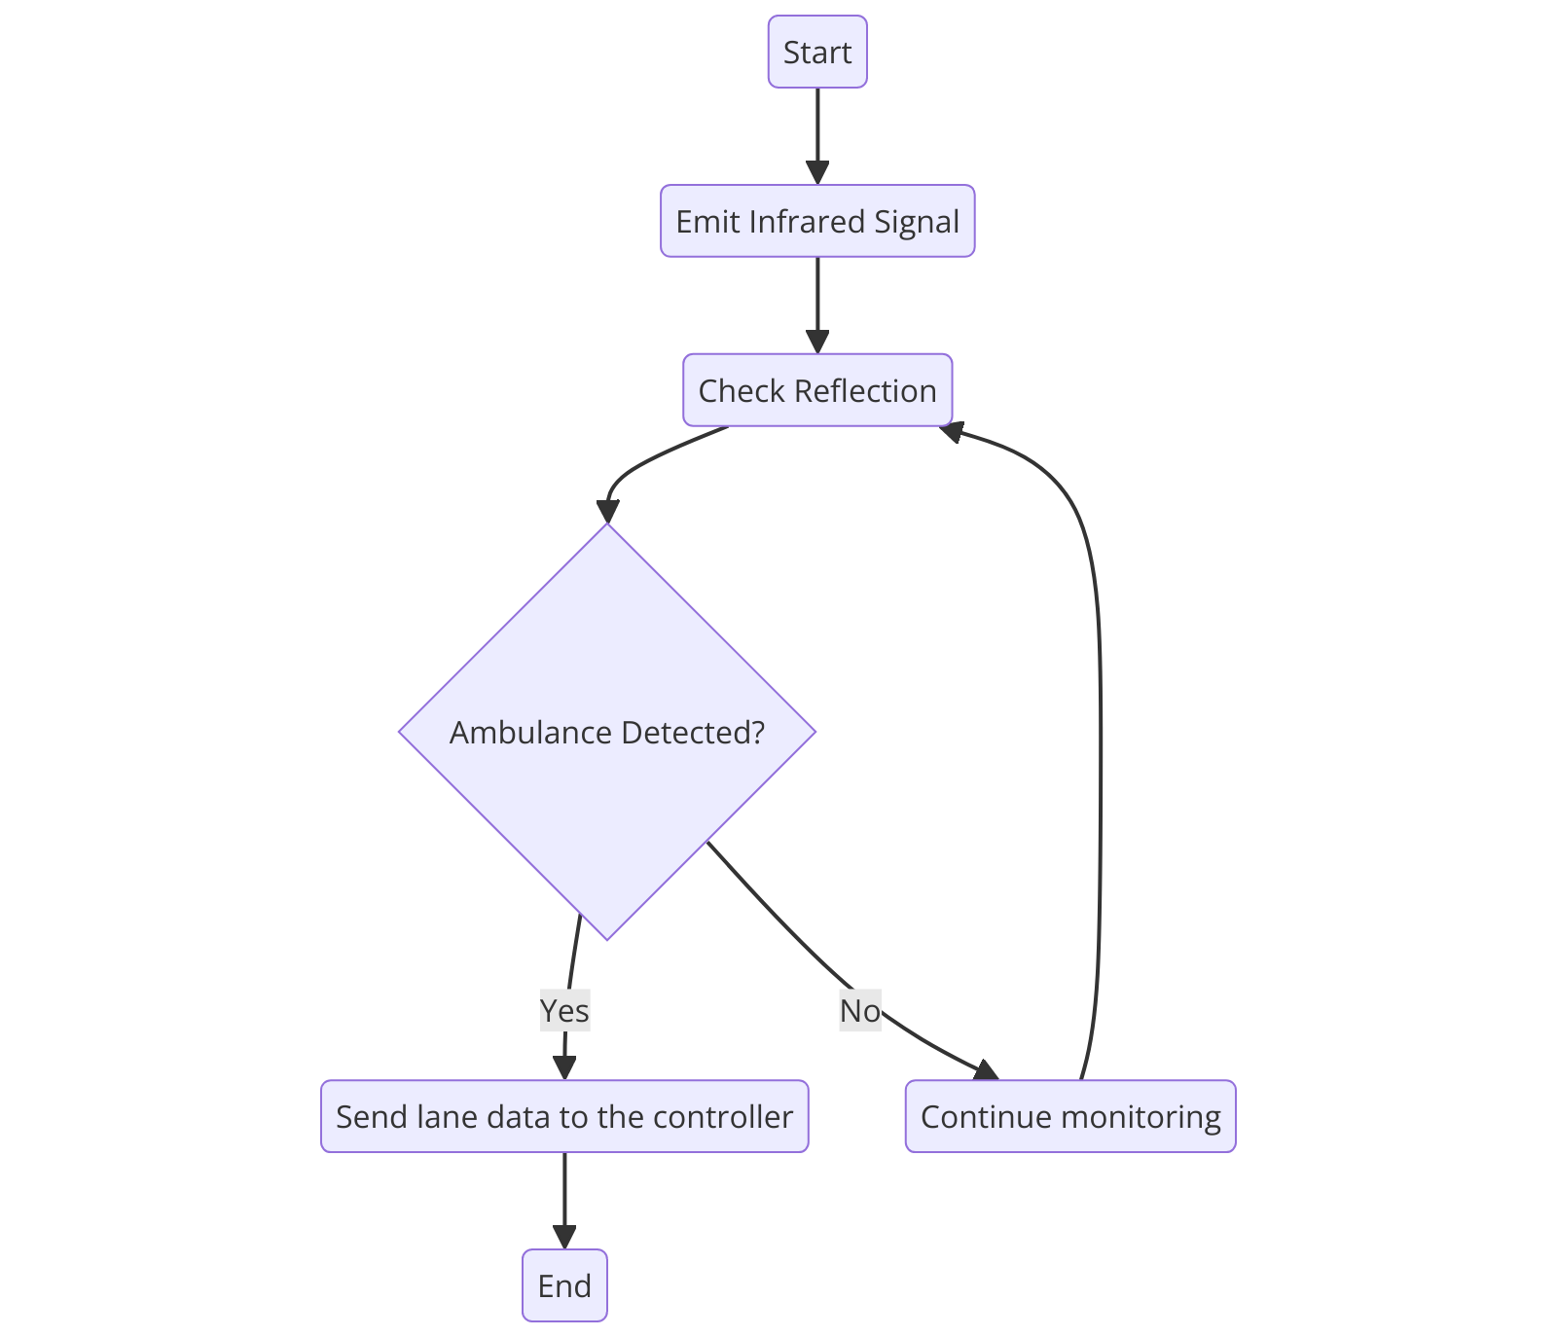
Functional Description for each modules with DFD and Activity Diagram
IR Sensor Module for Lane Detection
Functionality: Detects the presence of vehicles, especially ambulances, in designated lanes. The IR sensors emit infrared light and detect reflections from objects, identifying lane occupancy and relaying this information to the central controller.
Activity Diagram:

Slide 10
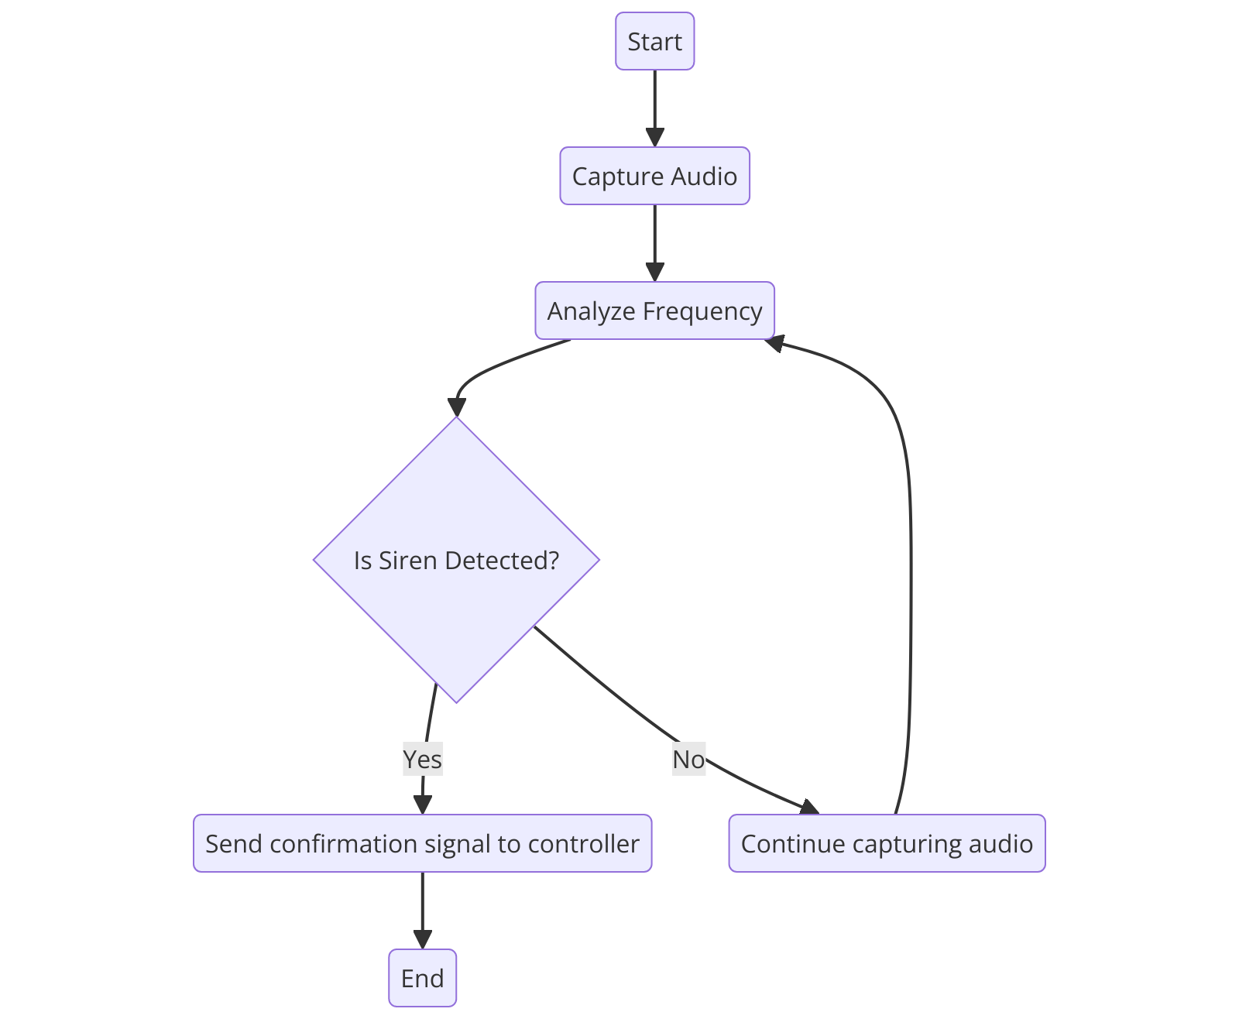
Functional Description for each modules with DFD and Activity Diagram
Voice Recognition Module for Siren Detection
Functionality: Identifies ambulance siren sounds to confirm the presence of an active emergency vehicle. Filters out background noise to ensure accurate detection, even in congested areas.
Activity Diagram:

Slide 11
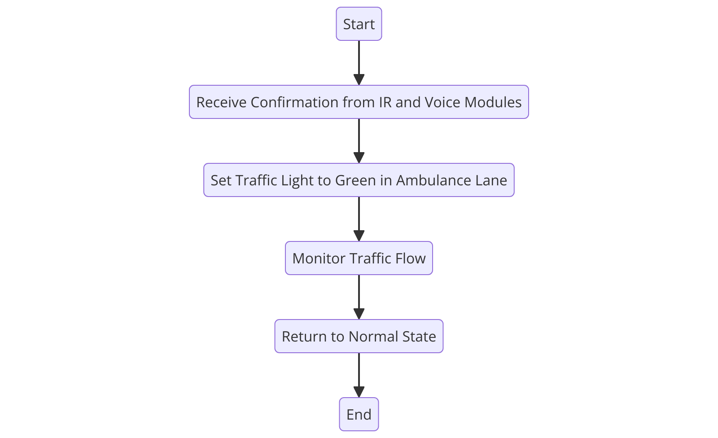
Functional Description for each modules with DFD and Activity Diagram
Traffic Light Management Module
Functionality: Manages traffic lights based on data from the IR sensors and voice recognition module. Prioritizes lanes with emergency vehicles by switching traffic lights accordingly.
Activity Diagram:

Slide 12
Implementation & Results of First Module
Implementation of the Voice Recognition Module
1. Overview: This module uses a pre-trained voice recognition algorithm to identify the frequency and sound pattern of ambulance sirens. It ensures that the system only reacts to emergency vehicle sirens, minimizing false detections from other sounds.
2. Functionality:
Sound Recognition: The module processes audio input in real-time, filtering out background noise and recognizing the specific siren frequency.
Signal Transmission: Upon detecting an ambulance siren, the module sends a confirmation signal to the Arduino Uno. This initiates the traffic light change to prioritize the ambulance lane.

Slide 13
3. Hardware and Software:
Hardware: The module includes a microphone for audio input, connected to the Arduino Uno, which processes signals based on predefined parameters.
Software: Embedded C programming in the Arduino IDE configures the voice recognition system to differentiate the unique frequency pattern of sirens.
Results of the Voice Recognition Module
Accuracy in Detection: Tests in various noise environments confirm the module's capability to distinguish ambulance sirens from other urban sounds, reducing false positives.
Latency: The module responds quickly, allowing the traffic system to change the lights in real-time, minimizing delays in ambulance passage.

Slide 14
Conclusion & Work for Phase II
Conclusion
The project demonstrates a practical solution to the critical issue of traffic congestion affecting ambulance movement in urban settings. By utilizing an automated system that integrates IR sensors for lane detection, a voice recognition module for detecting ambulance sirens, and an Arduino Uno-controlled traffic light management system, it prioritizes emergency vehicles efficiently. The IR sensors accurately determine the ambulance's lane, and the voice recognition module confirms its presence. The system then adjusts traffic signals to clear the way, which significantly enhances emergency response times, reduces the risk of delays in medical assistance, and improves public safety. This real-time, autonomous solution is adaptable to various urban environments and demonstrates the transformative impact of technology in smart traffic management for public safety.

Slide 15
Future Work for Phase II
1. GPS and V2I Integration: Adding GPS and vehicle-to-infrastructure (V2I) communication will allow the system to track ambulances' real-time locations and coordinate traffic signals over a wider area. This would create a more dynamic system that adjusts traffic lights along the ambulance's entire route.
2. AI-Driven Traffic Prediction: Implementing artificial intelligence to analyze traffic patterns can help the system predict congestion points and proactively adjust traffic flows, further reducing delays.

Slide 16
3. Centralized Cloud-Based Monitoring: Incorporating cloud data management would enable centralized monitoring, allowing traffic authorities to track emergency vehicles and optimize response strategies across an entire city.
4. V2V Communication: Expanding the system to include vehicle-to-vehicle (V2V) communication would prompt nearby vehicles to move aside automatically when an ambulance is detected, enhancing safety.
5. Solar-Powered Traffic Lights: To improve reliability in areas with unstable power supplies, solar-powered traffic lights could be introduced, ensuring uninterrupted operation of the traffic management system.

Slide 17
References
[1] Ram et al., IoT Enabled Real-Time Traffic Management System, International Journal of Advanced Science and Technology, 2020.
[2] Patel et al., Review of Emergency Vehicle Priority Systems, IEEE Transactions, 2020.
[3] Dutta et al., Intelligent Traffic Control System: Towards Smart City, IEEE Conference Proceedings, 2019.
[4] Hussian et al., WSN Applications: Automated Intelligent Traffic Control System, International Journal of Soft Computing and Engineering, 2013.
[5] Jain et al., Road Traffic Congestion in Developing Regions, ACM Symposium on Computing for Development, 2012.

Slide 18
Thank You

